Slide 1

Academic researchers for Dengue Therapeutics
Presented By:
Group 9

Slide 2
Table of Contents
Active researchers
Working relationship between researchers
Additional visualizations
Result

Slide 3
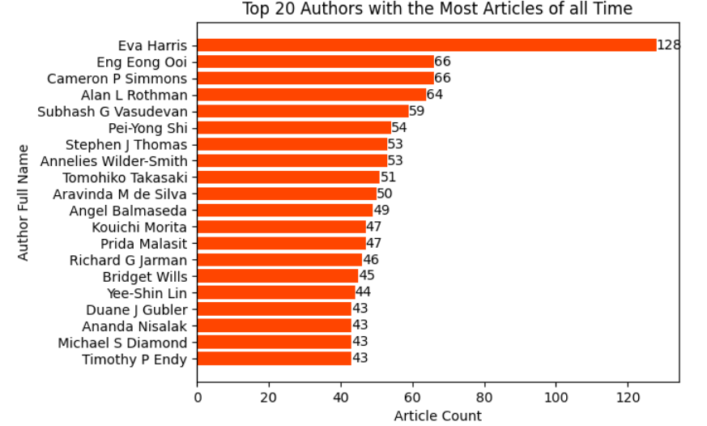
Active researchers - All Time Data

Slide 4
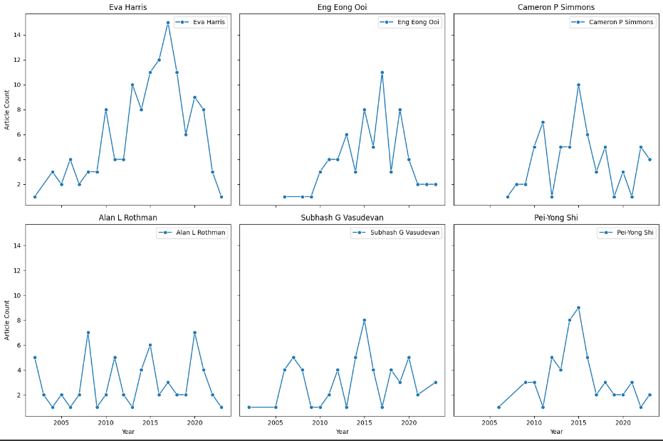
Number of articles published by Top 6 researchers per year

Slide 5
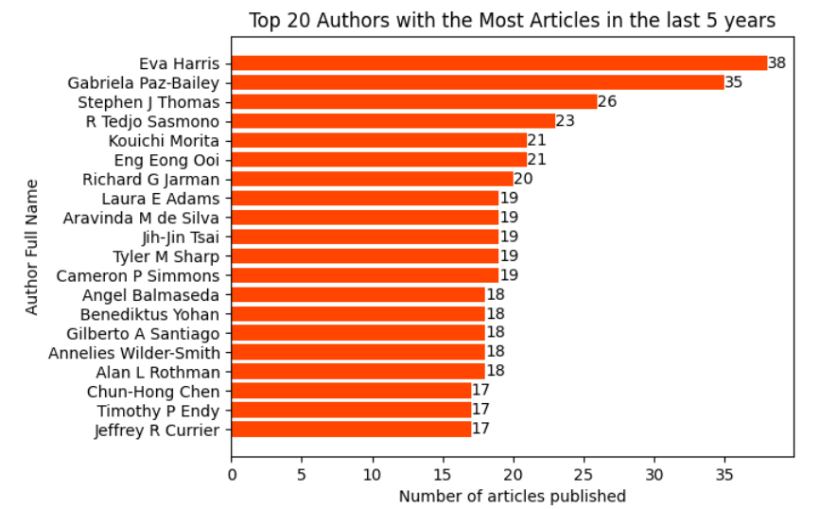
Active researchers - Last 5 Years

Slide 6
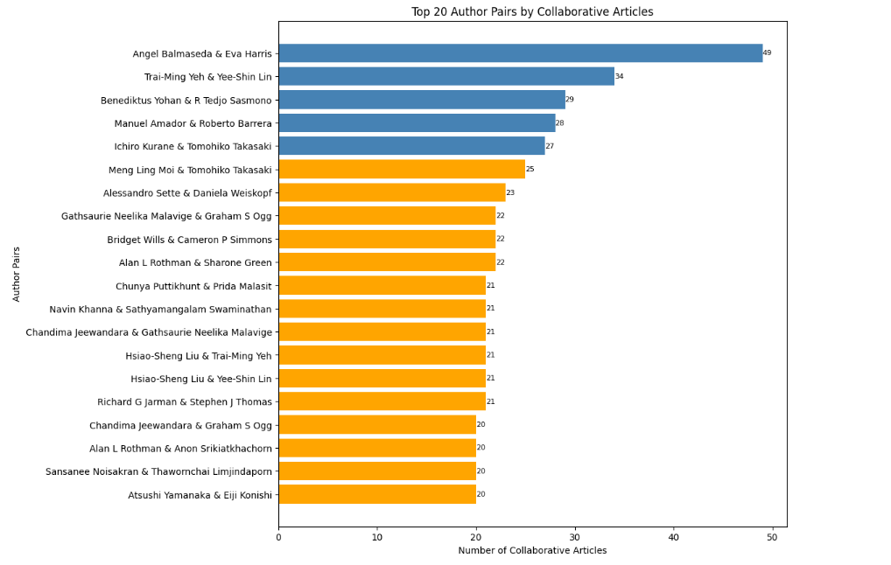
Working relationship between researchers
The top 20 Author who collaborated with each other in articles.

Slide 7
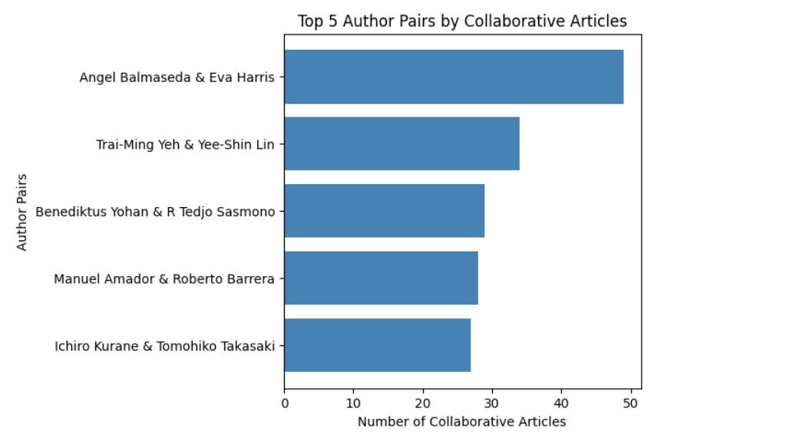
Top 5 pair of collaborations

Slide 8
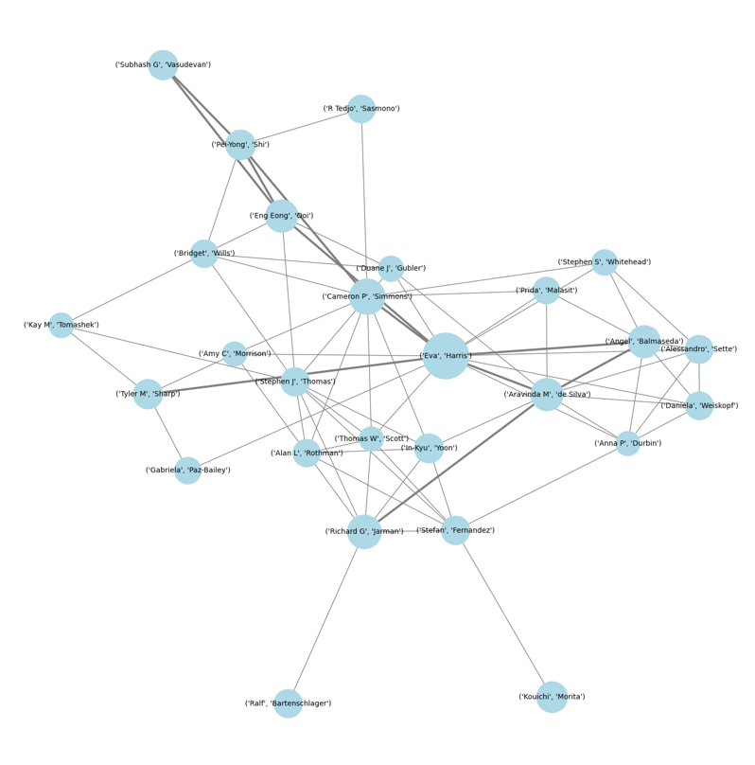
Top 30 Collaborators
Top 30 collaborators based on the full name.

Slide 9
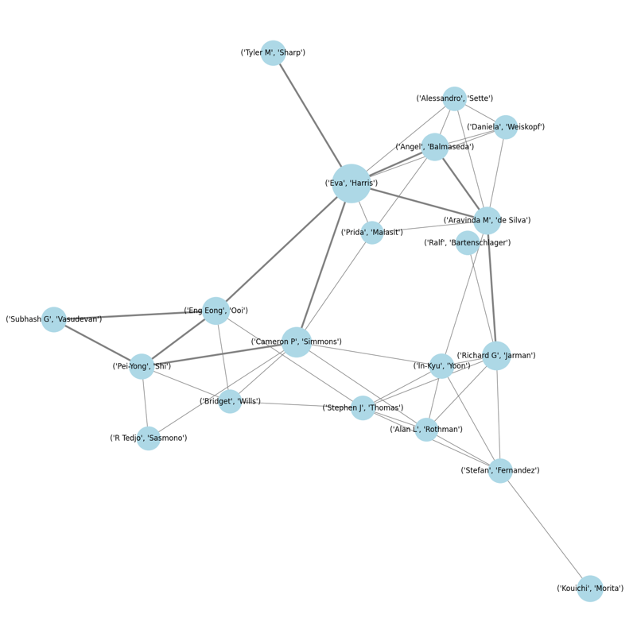
Top 20 Collaborators

Slide 10
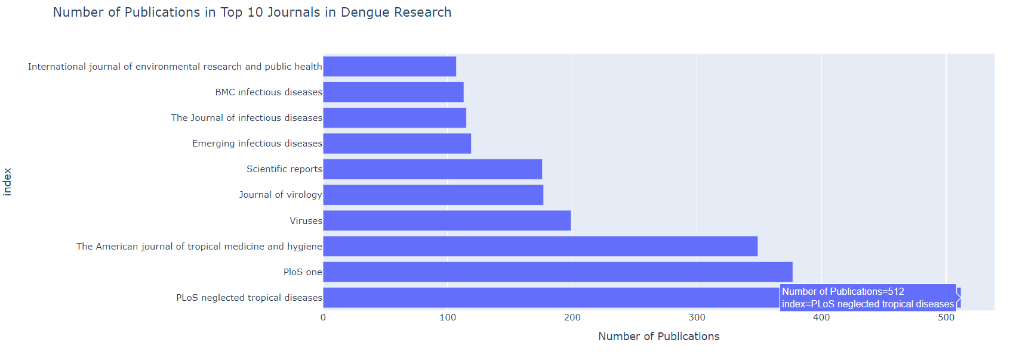
Number of Publications in Top 10 Journals

Slide 11
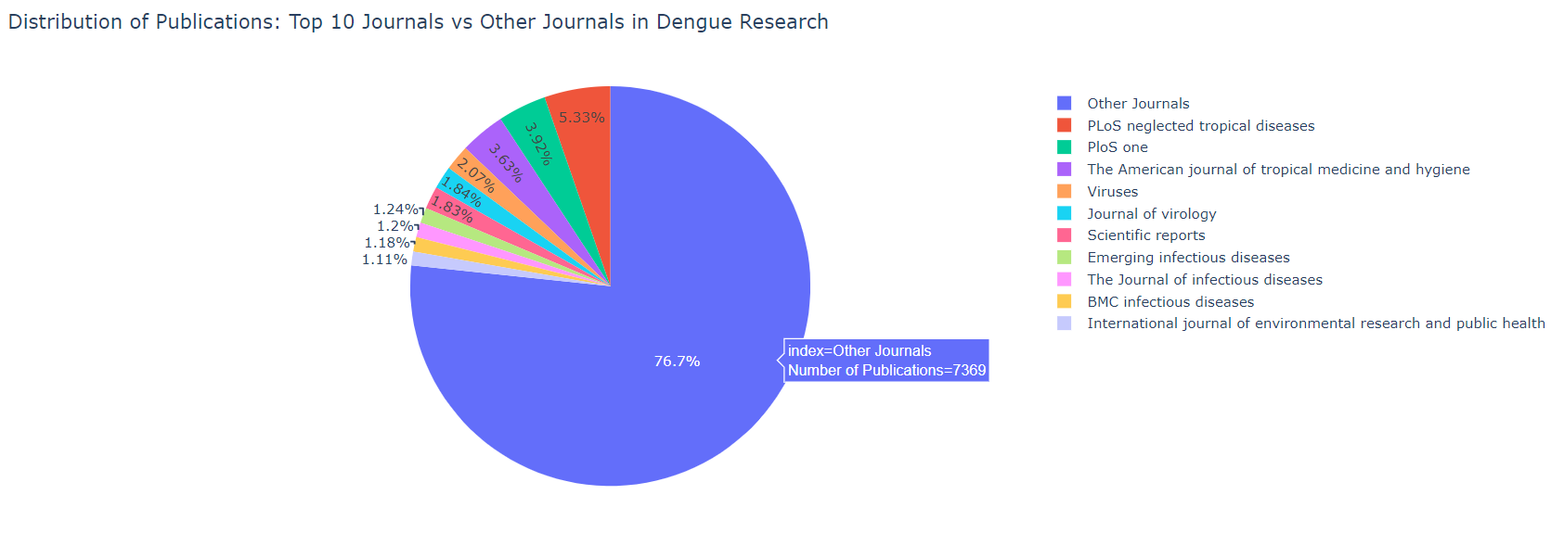
Distribution of Publications: Top 10 Journals vs other Journals

Slide 12
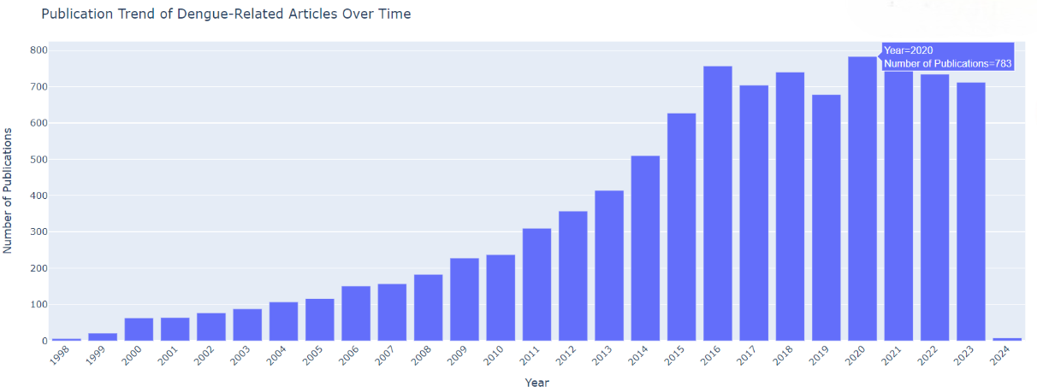
Publication Trend of Dengue-Related Articles Over Time

Slide 13
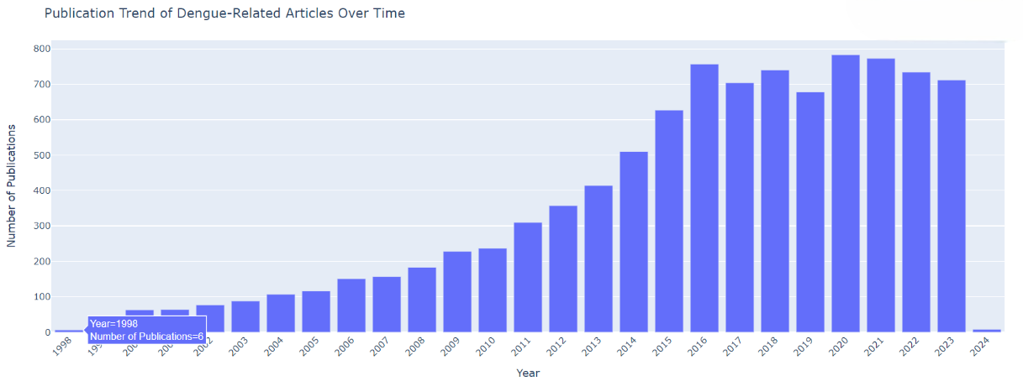
Publication Trend of Dengue-Related Articles Over Time

Slide 14
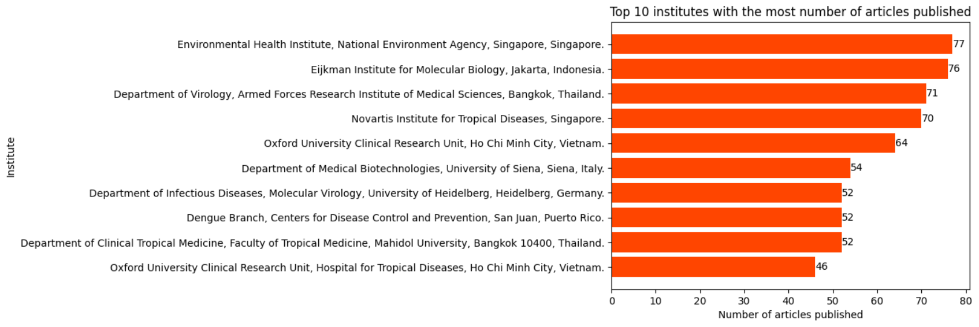
Top 10 institutions with the most publications
Additional visualizations

Slide 15
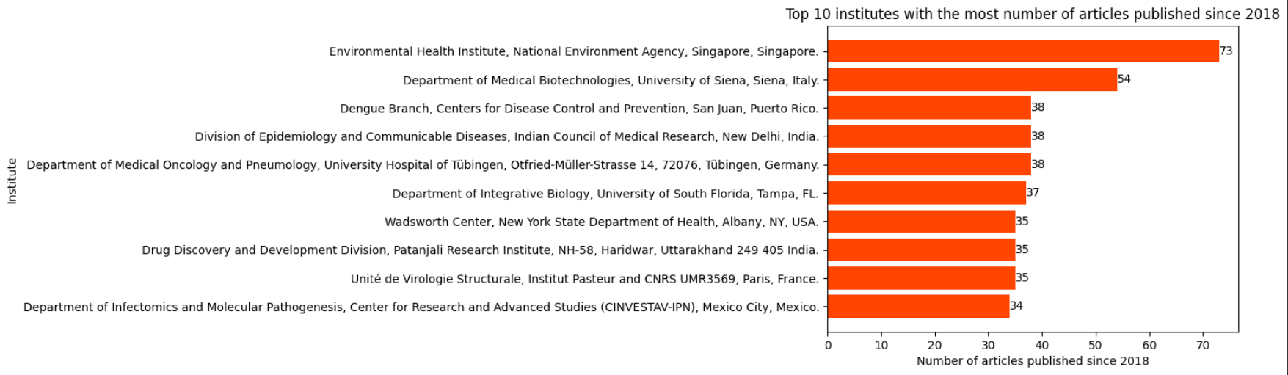
Top 10 institutions with the most publications since 2018

Slide 16
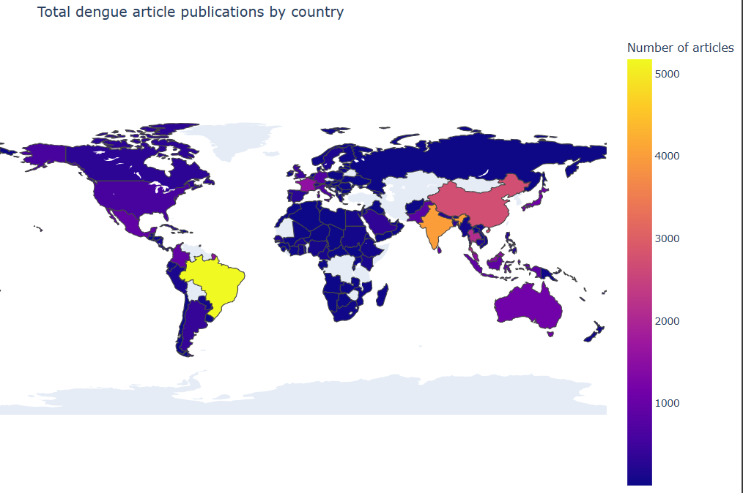
Total dengue article publications by country

Slide 17
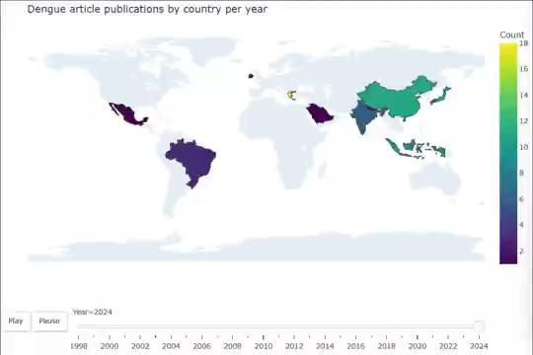
Dengue article publications by country per year

Slide 18
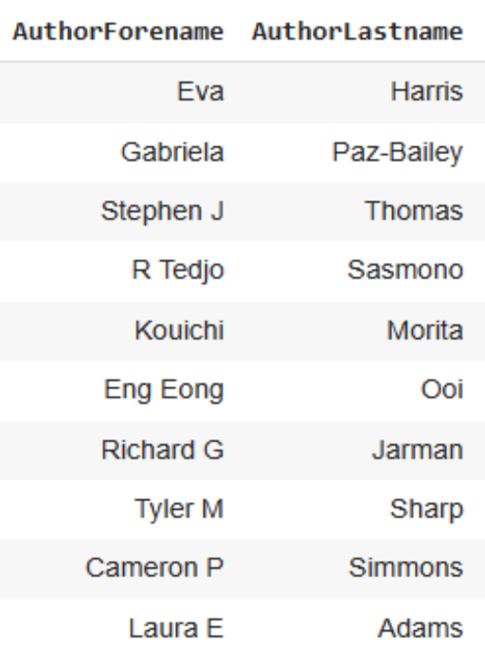
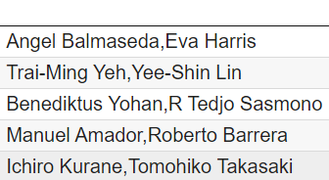



Result
Top 10 active researchers
Author Collaborations
Top 5 authors with most collaborations
Most collaborations by the top 3 most active authors

Slide 19
Best researchers to work with
Eva Harris
Best collaborator: Angel Balmaseda
Gabriela Paz-Bailey
Best collaborator: Laura E Adams
Stephen J Thomas
Best collaborator: Timothy P Endy

Slide 20
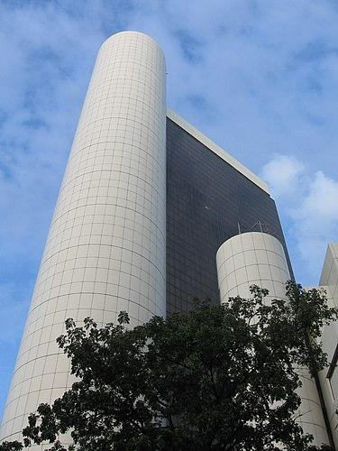
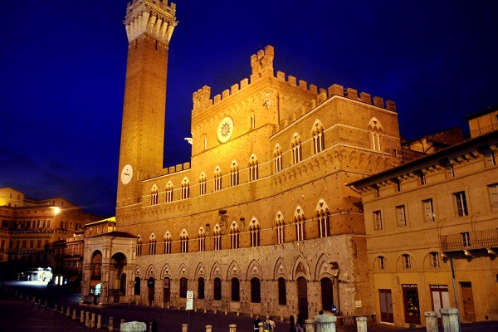

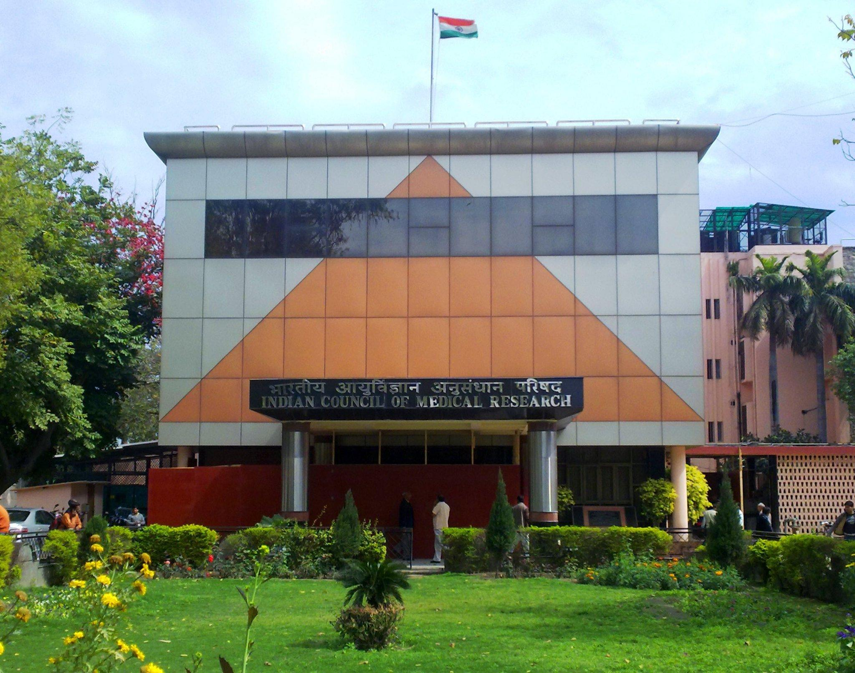
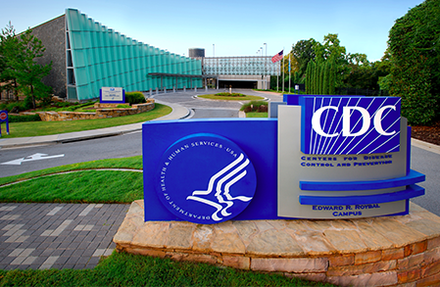
Top 5 currently active institutions
National Environment Agency, Singapore, Singapore.
University of Siena, Siena, Italy.
University Hospital of Tübingen, Tübingen, Germany.
Indian Council of Medical Research, New Delhi, India.
Centers for Disease Control and Prevention, San Juan, Puerto Rico.

Slide 21
ANY QUESTIONS?

Slide 22
Thank you

